Slide 1

D212 Data Mining II Performance Assessment: Task 1 Cluster Analysis
Jill Rivera, Student
Masters of Science: Data Analytics
Western Governors University
Notes:
Hello and welcome. My name is Jill Rivera, and I am a student in the Master of Science in Data Analytics program at Western Governors University. Today I will be presenting the performance assessment for D212 Data Mining II, Task 1 on clustering analysis.

Slide 2

Agenda
Research Question
Clustering Analysis Technique
Technical Environment
Data Preparation
K-Means Clustering Analysis
Data Summary and Implications
Notes:
This presentation will first review the research question created for this clustering analysis based on the data dictionary provided with the data set. The technique used to perform the clustering analysis is discussed for its assumptions and method. The technical environment used to perform the analysis will be explained before showing the way the data is prepared for analysis. The K-Means clustering analysis is performed, and then the results and limitations are covered in a data summary.

Slide 3


Research Question
What key attributes impact churned customers the most?
Notes:
A telecommunications company is trying to develop a better understanding of their customers. They want to know why their customers are churning and how they can develop a better relationship with these customers. To analyze this, the question: What key attributes impact churned customers the most? will be answered. To answer and analyze the research question posed, a clustering technique called K-Means will be performed. Clustering is the collection of data points that are aggregated together due to their similarities. The goal of this analysis will be to determine two to three key attributes that are impactful to the customer churning from the company. Once these variables are identified, new marketing campaigns and target products can be developed to retain future customers with similar attributes.

Slide 4
Clustering Analysis Technique
K-Means Clustering Analysis
Goal: Determine 2-3 key attributes that are impactful to the customer churning from the company.
Assumption: All variables are continuous numerical in type.
Notes:
K-Means clustering is a simple yet popular method of unsupervised machine learning that can answer this question easily. K-Means looks for a fixed number (k) of clusters in a data set ((LEDU), 2018) which is exactly what is necessary for this analysis. The k determines the number of centroids you wish to identify and cluster similar data points around. With this analysis, you end up with a distinct set of clusters in which the data points are measured to be a Euclidian distance from a centroid of that cluster. For this analysis, we will be looking for two to three centroids surrounded by data points that are related. The K-Means clustering technique requires that all the variables are continuous numerical values. This technique is unable to integrate categorical variables due to the structure of the calculations. The data will be prepared based on this assumption.

Slide 5


Technical Environment
Jupyter Notebook
Python
Pandas
Numpy
Matplotlib
Kmeans
StandardScaler
KneeLocator
Notes:
The Python programming language in a Jupyter Notebook will be used to perform this analysis. Python is an easy to read, open-source language that can calculate this analysis with only a few helping packages. Pandas will be used to read and export the data set. Numpy will be used to manipulate the data set and conduct exploratory analysis on the data. Matplotlib is a very useful package, used to visualize the data in graphs. Scikit Learn provides the KMeans package with all the necessary formulas as well as StandardScaler which is an algorithm to scale the data. Finally, I will use the Kneed package with KneeLocator to use the elbow method to get the number of clusters for the analysis.

Slide 6
Data Preparation: Preprocessing Goal
Reduce Data Set
All variables are continuous numerical in data type.
Notes:
The data preparation was conducted on the data set with the assumptions of K-Means clustering in mind. The major goal to be achieved by preprocessing the data is to reduce the data set to include only continuous numerical variables. This is due to the assumption of the K-Means technique discussed previously.

Slide 7
Initial Variables
Categorical Data
Label | Values
Area | Urban, Suburban, Rural
Marital | Married, Widowed, Separated, Never Married, Divorced
Gender | Female, Male, Nonbinary
Churn | Yes, No
Techie | Yes, No
Contract | Month-to-month, Two Year, One Year
Port_modem | Yes, No
Tablet | Yes, No
InternetService | Fiber Optic, DSL, None
Phone | Yes, No
Customer_id | Unique customer identification
Interaction | Unique alpha-numeric combination
UID | Unique alpha-numeric combination
City | City Name of Customer
Job | Customer’s Profession
State | State code
County | County of Customer
Zip | Zip Code of Customer
Lat | Latitude of Customer
Lng | Longitude of Customer
TimeZone | Time Zone of Customer
Multiple | Yes, No
OnlineSecurity | Yes, No
OnlineBackup | Yes, No
DeviceProtection | Yes, No
TechSupport | Yes, No
StreamingTV | Yes, No
PaperlessBilling | Yes, No
PaymentMethod | Bank Transfer(automatic), Credit Card (automatic), Mailed Check, Electronic Check
Item1 | Survey Response Rank of 1 through 5
Item2 | Survey Response Rank of 1 through 5
Item3 | Survey Response Rank of 1 through 5
Item4 | Survey Response Rank of 1 through 5
Item5 | Survey Response Rank of 1 through 5
Item6 | Survey Response Rank of 1 through 5
Item7 | Survey Response Rank of 1 through 5
Item8 | Survey Response Rank of 1 through 5
Continuous Data
Label | Data Type | Example
Population | Int | 8508
Children | Int | 1
Age | Int | 53
Income | Float | 38329.40
Outage_sec_perweek | Float | 10.01
Email | Int | 12
Contacts | Int | 1
Yearly_equip_failure | Int | 1
Tenure | Int | 34
MonthlyCharge | Float | 172.78
Bandwidth_GB_Year | Float | 3379.46
CaseOrder | Int | 5
Notes:
The data set is made up of 10,000 rows of customer data for a telecommunications company. The initial data set includes 50 attributes listed in the tables along with their data type and an example. There are two tables, one for categorical data and the second for continuous data.

Slide 8
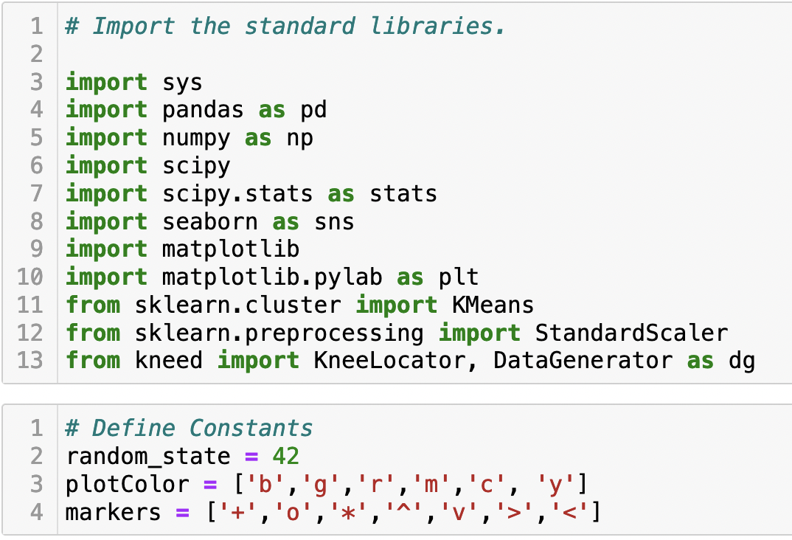
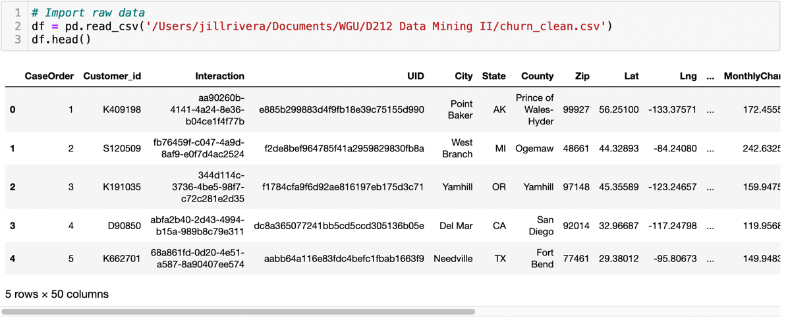
Data Preparation: Importing Data
Notes:
The following steps were taken to prepare the data for the K-Means analysis. Before the data is imported and manipulated, the packages needed for this analysis are imported into the Jupyter Notebook and the constants are defined. The Panda package is used to read the csv file and import the data into the notebook. The head command is then used to show the first five rows of the data frame.

Slide 9
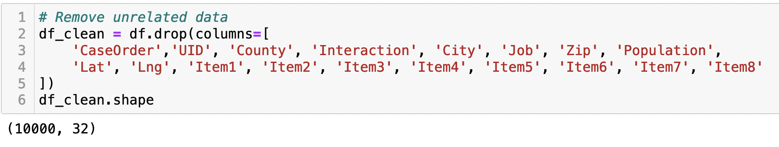
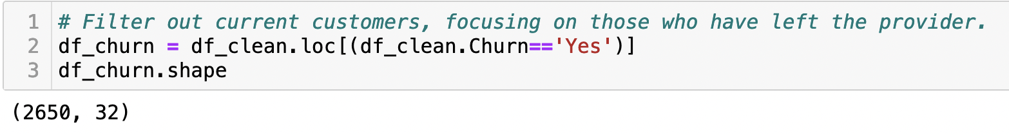
Data Preparation: Data Cleaning
Notes:
For this analysis, we have too much data and it needs to be reduced in size before running the calculations. First, the variables that are not helpful to this analysis are removed using the drop function. Next, a separate data frame for only customers who have churned is created by using the location function.

Slide 10
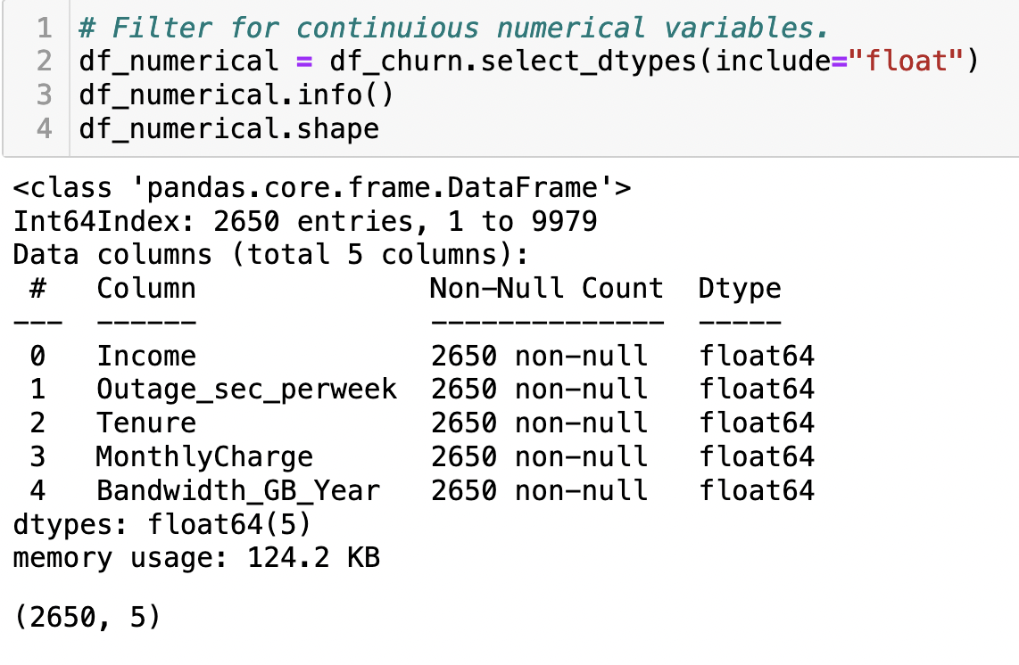
Data Preparation: Data Cleaning
Notes:
Now, in keeping true to the assumption of the variables all being continuous numerical in type, another data frame for only numerical data is created. We now have a data frame that is 2,650 rows and five data attributes.

Slide 11
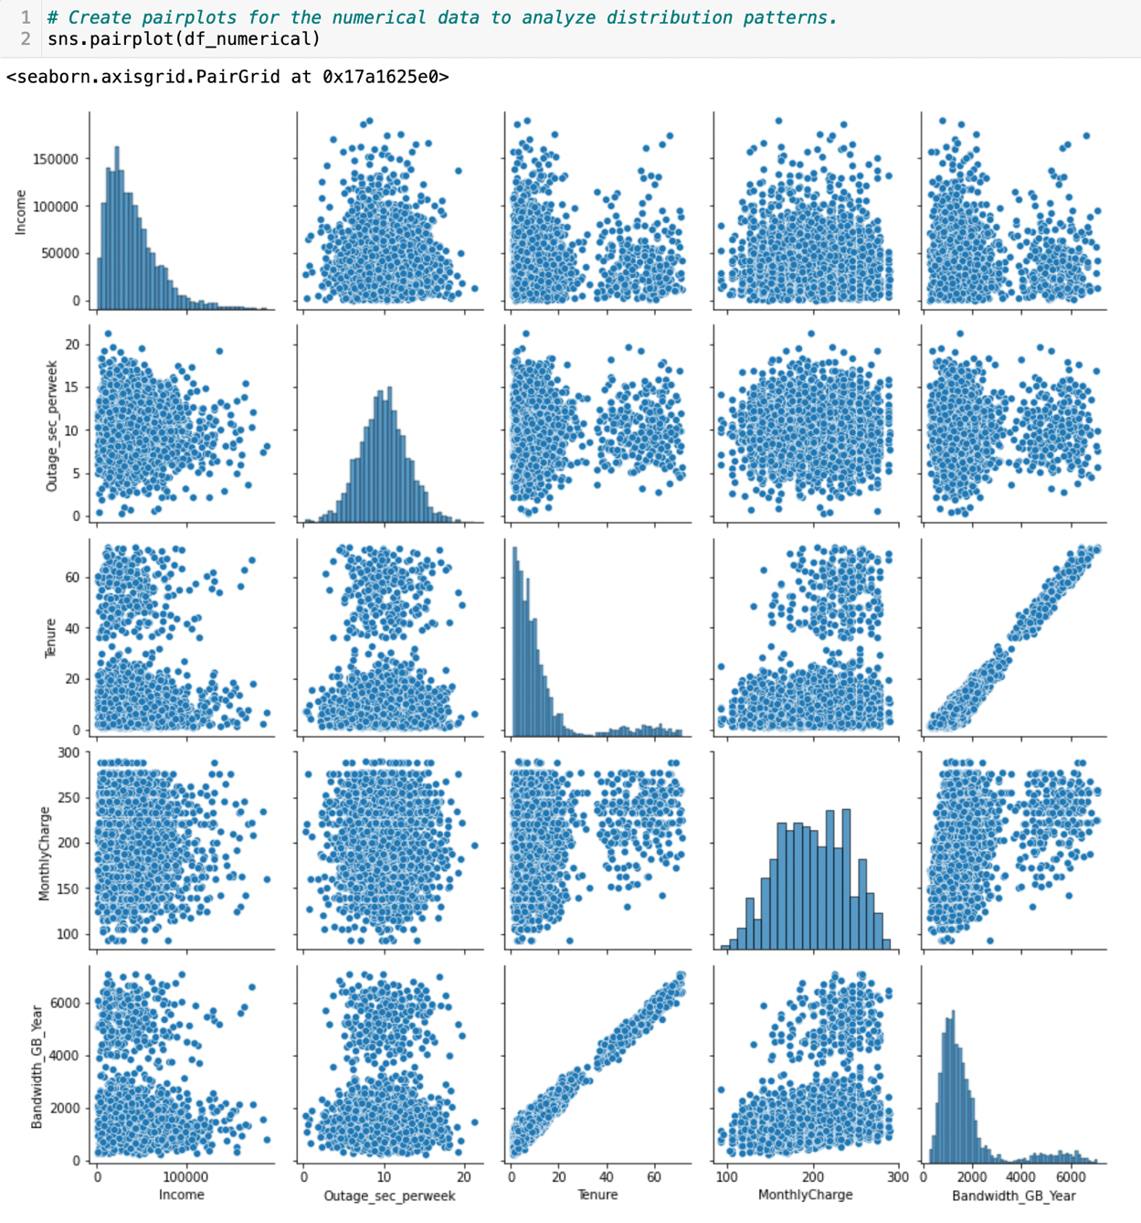
Data Preparation: Data Exploration
Notes:
Now that the data frame is a more manageable size and consists of only numerical data points on customers who have left the provider, we can explore the data. First, a pair plot is created on the data frame using Seaborn. This plot is used to look at the relationship between each of the variables. For this analysis, those with a linear relationship will be noted as they can skew the results of the calculation.

Slide 12
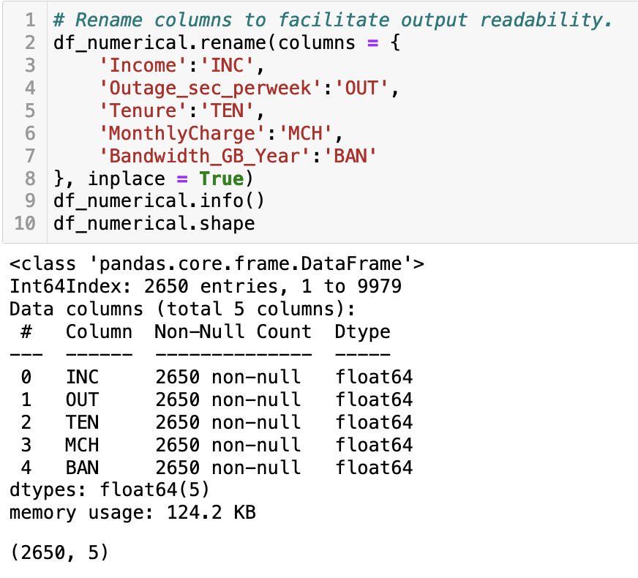
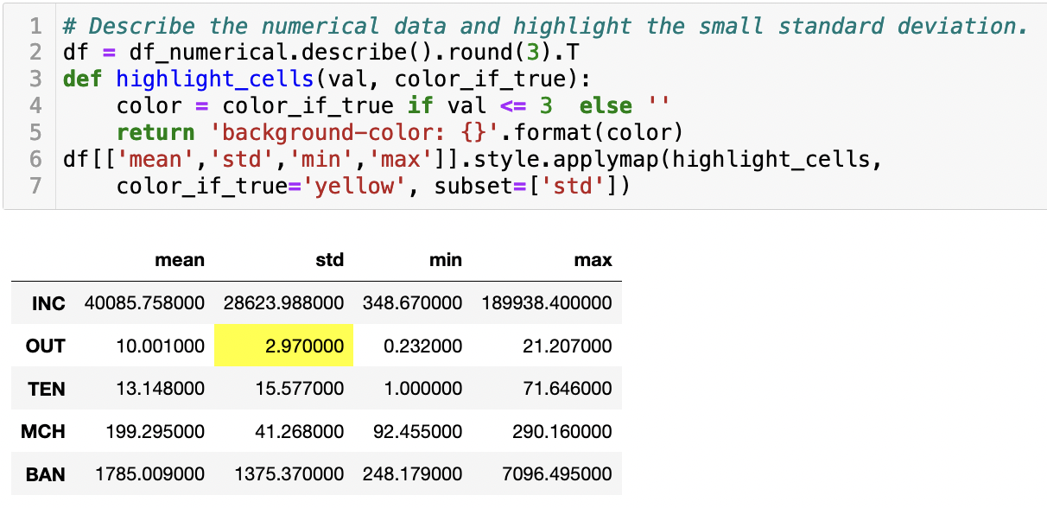
Data Preparation: Data Exploration
Notes:
Next, the variables are renamed to make the graphs easier to read. The standard metrics of the variables are displayed using the describe method.

Slide 13
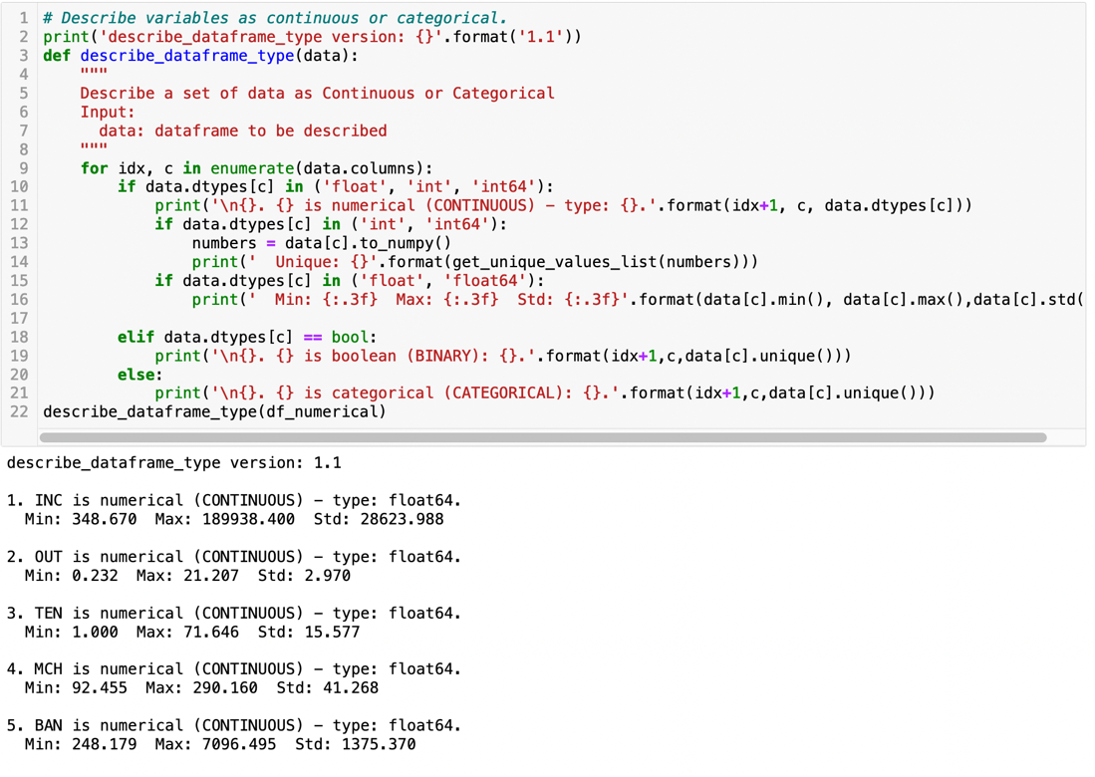
Data Preparation: Data Exploration

Slide 14
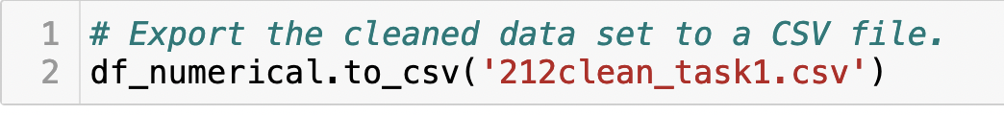
Data Preparation: Exporting Data
Notes:
The data frame that will be used for the analysis is exported from the notebook into a csv file labeled “212clean_task1.csv” using Pandas. This file is attached in this submission for review.

Slide 15
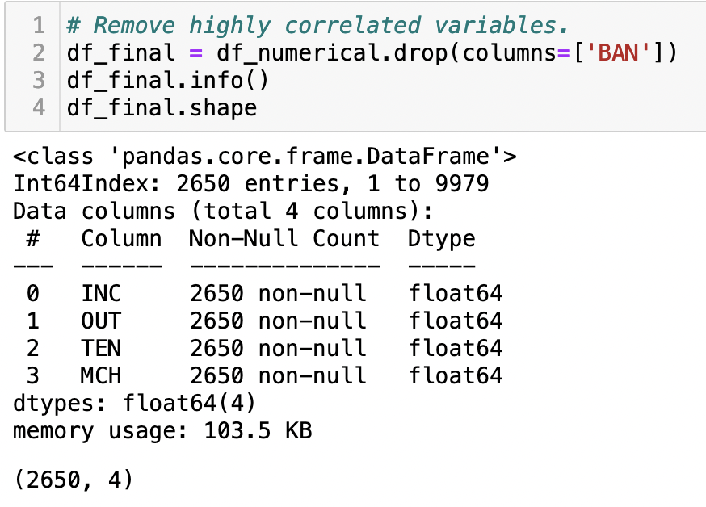
K-Means Analysis: Correlated Variables
Notes:
Clustering analysis is performed and analyzed using the K-Means unsupervised machine learning technique. To begin the K-Means calculations, first the variables which are highly correlated need to be removed. This was determined by the pair plot that was done previously in the data exploration step of the analysis. Since bandwidth and tenure were linear on the pair plot, bandwidth will be removed to reduce the linearity.

Slide 16
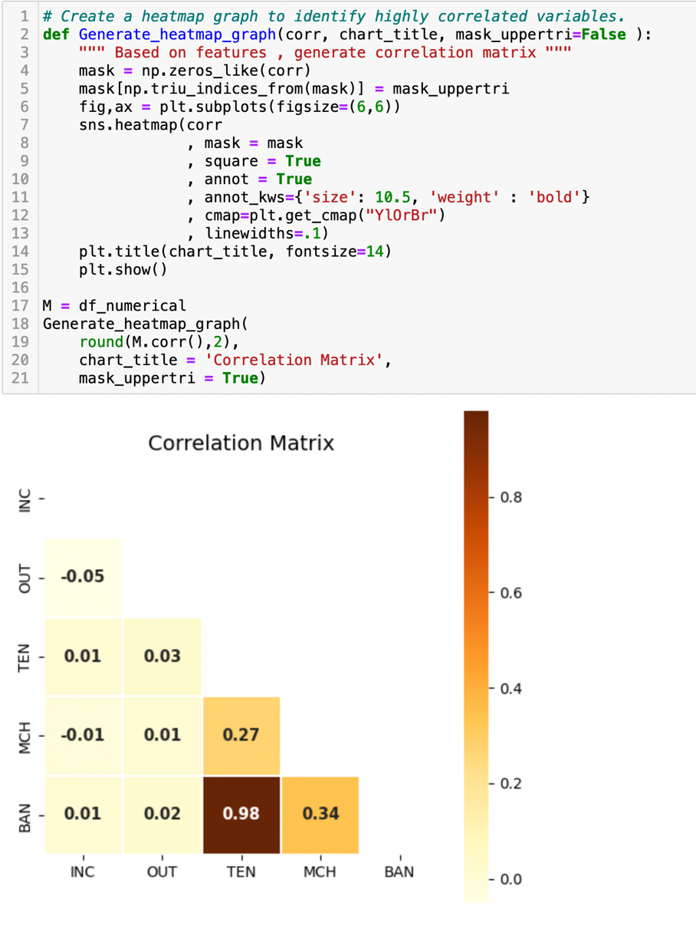
K-Means Analysis: Heatmap
Notes:
Next, a heatmap is created to verify which variables are highly related to each other.

Slide 17
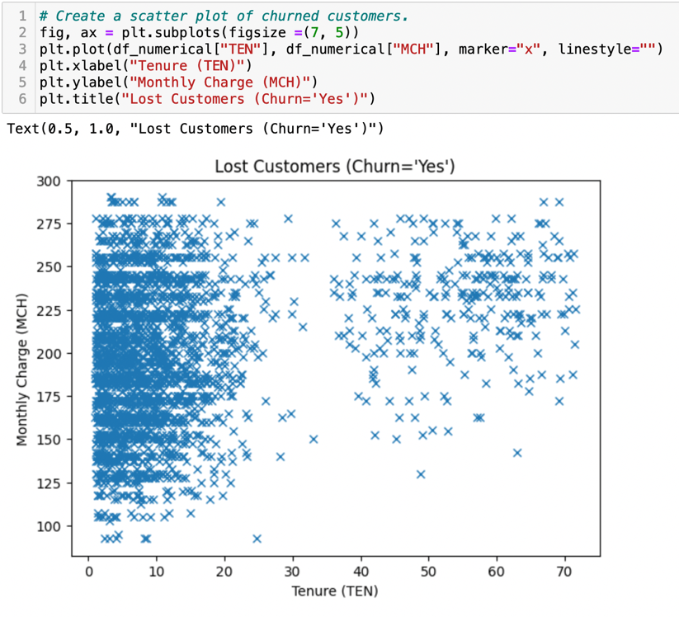
K-Means Analysis: Scatter Plot
Notes:
Then, a scatter plot is created for the two variables which show the highest correlation. The variables of monthly charge and tenure are selected for this from the heatmap.

Slide 18
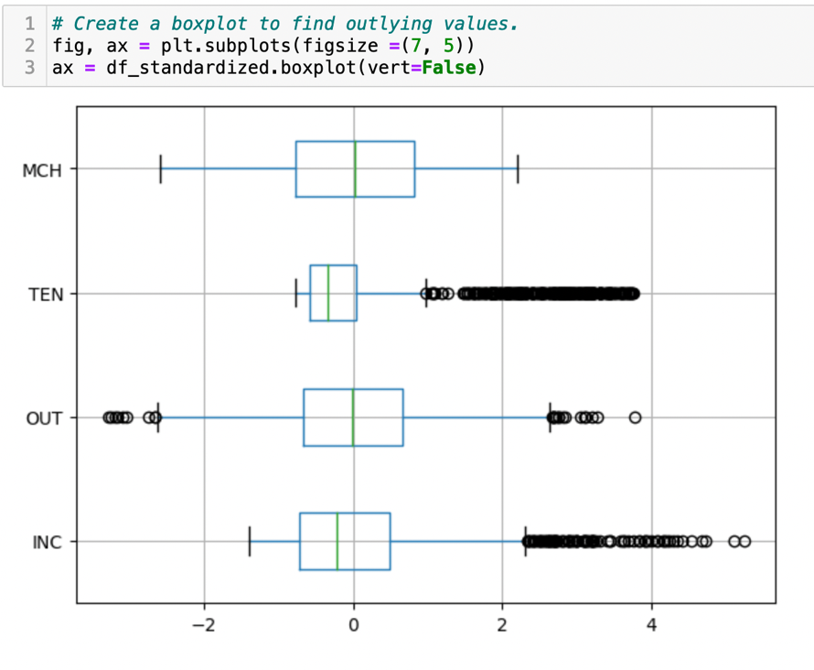
K-Means Analysis: Box Plot
Notes:
A box plot is produced to identify any outlying variables in the data.

Slide 19
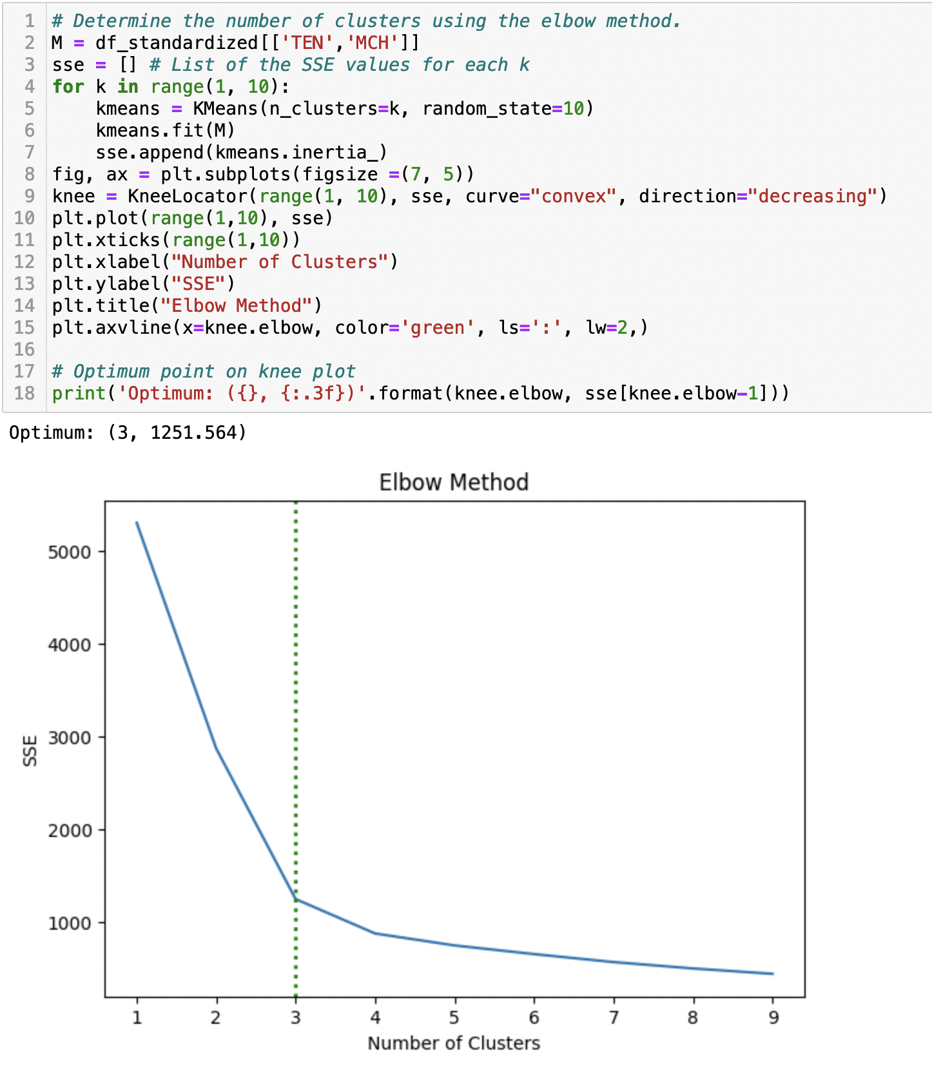
K-Means Analysis: Elbow Method
Notes:
When using the K-Means technique, there are two methods to determine the number of clusters that optimizes your model. These methods are the elbow method and the silhouette method. Both will be performed for this analysis. First, the elbow method is performed using the Knee Locator package installed previously. This method shows that three clusters is optimal.

Slide 20
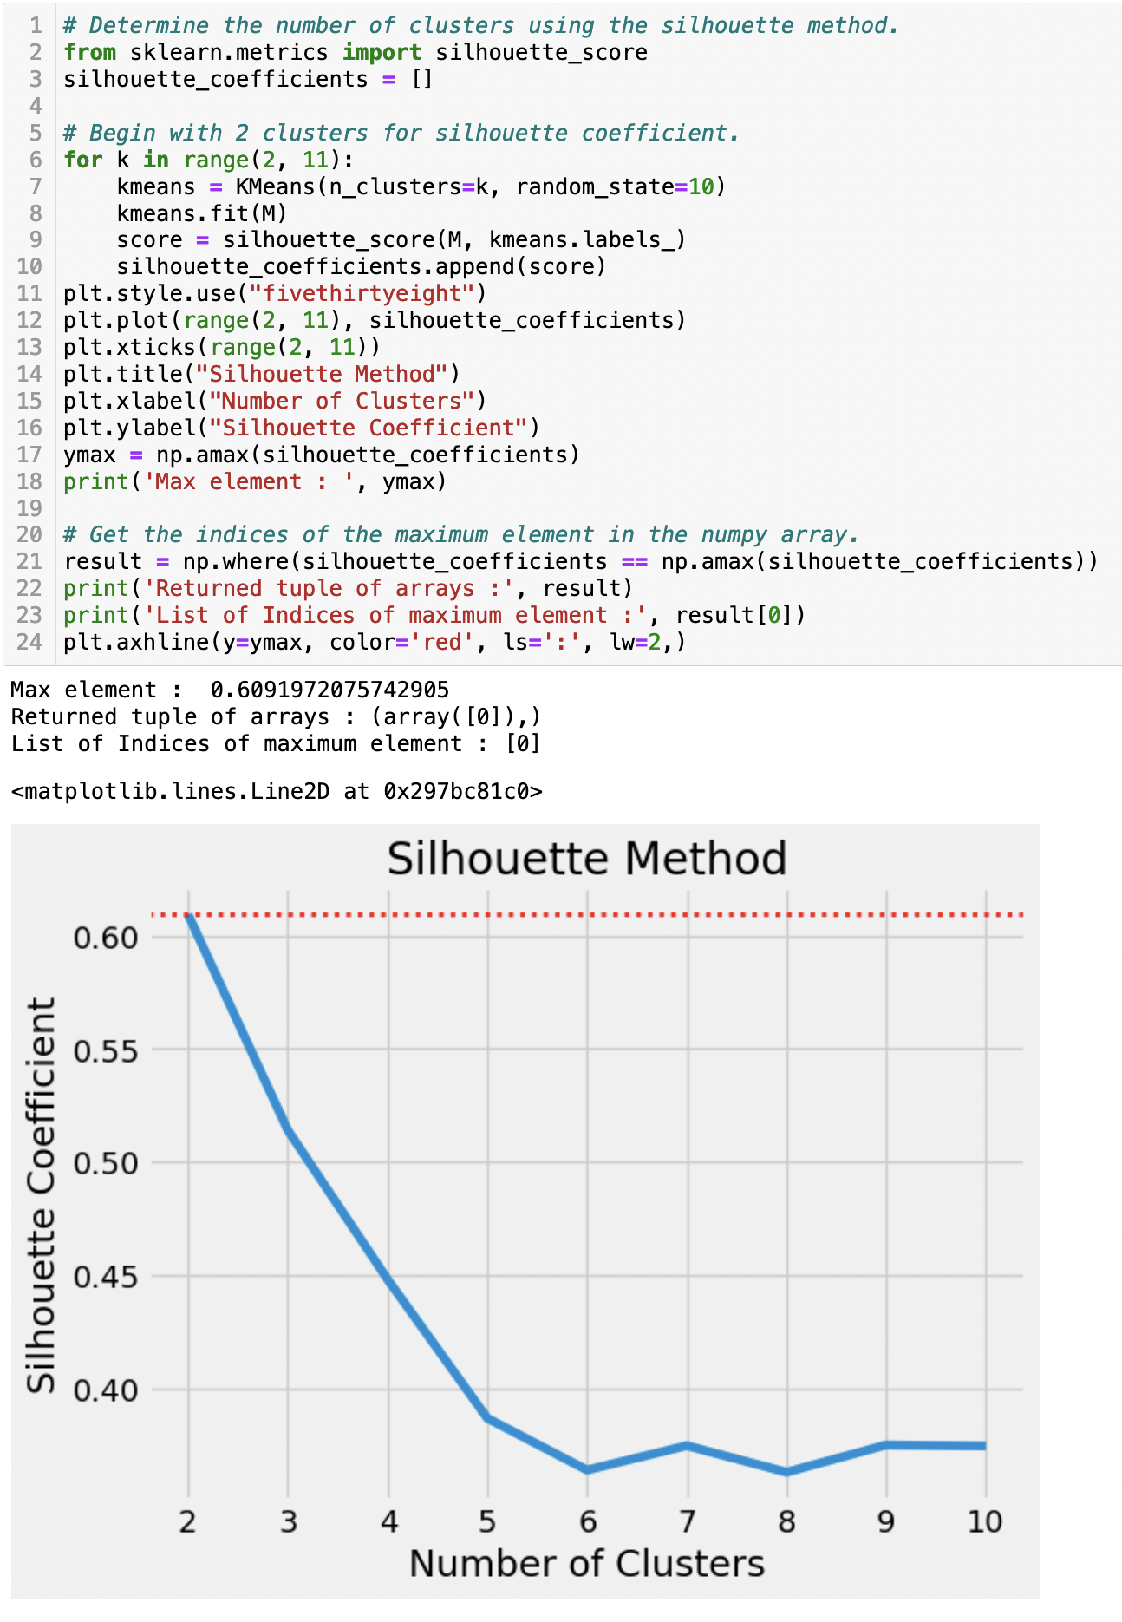
K-Means Analysis: Silhouette Method
Notes:
Next, performing the silhouette method from Scikit Learn, only two clusters are recommended for the analysis.

Slide 21
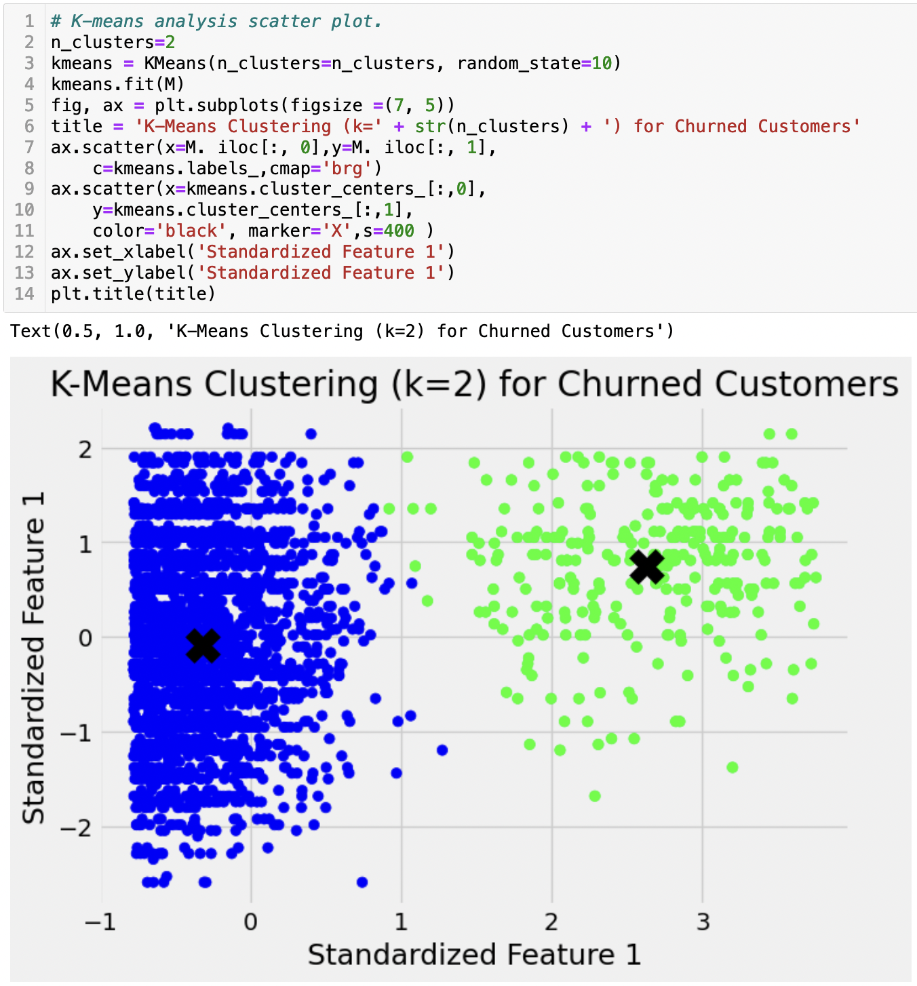
K-Means Analysis: Two Clusters
Notes:
Using the results of the silhouette method, the K-Means clustering analysis is performed using two clusters. Using KMeans from Scikit Learn, the k is set to two and the resulting initial model is created.

Slide 22
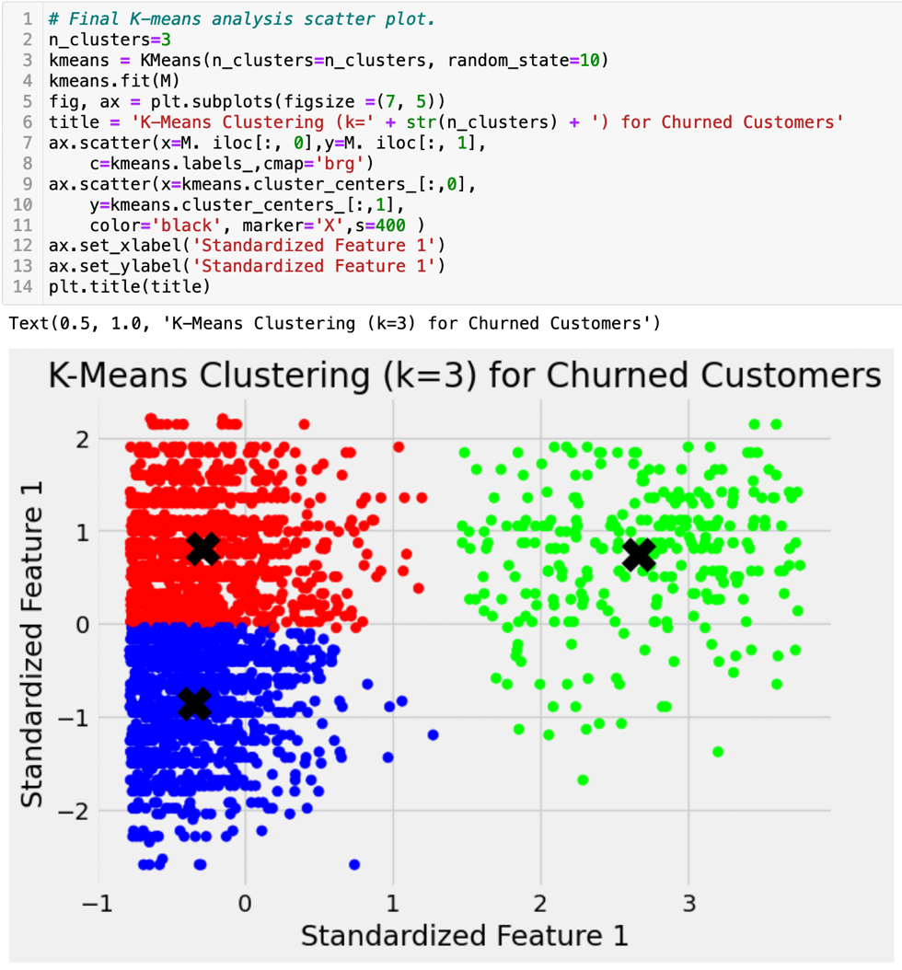
K-Means Analysis: Three Clusters
Notes:
Testing the data using the results of the elbow method is conducted next, setting the k value to three and producing the results shown in the scatter plot.

Slide 23
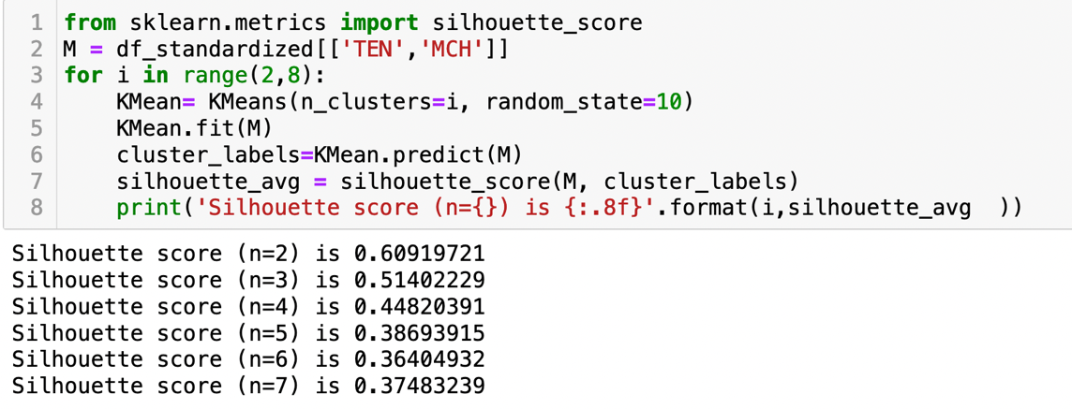
K-Means Analysis: Silhouette Coefficients
Notes:
The accuracy of the model created can be tested using the Silhouette Analysis Plot. First, the silhouette coefficient is calculated, which is a calculation of how cohesive the data points are for each k. The silhouette coefficient can range from -1 to 1. Interpreting this coefficient, a score close to 0 indicates overlapping of clusters, a value close to -1 shows a very spread-out cluster, and a score close to 1 represents a very compact cluster. (Banerji, 2022) For this analysis, k is maximized at 2 clusters with a coefficient of 0.6092.

Slide 24
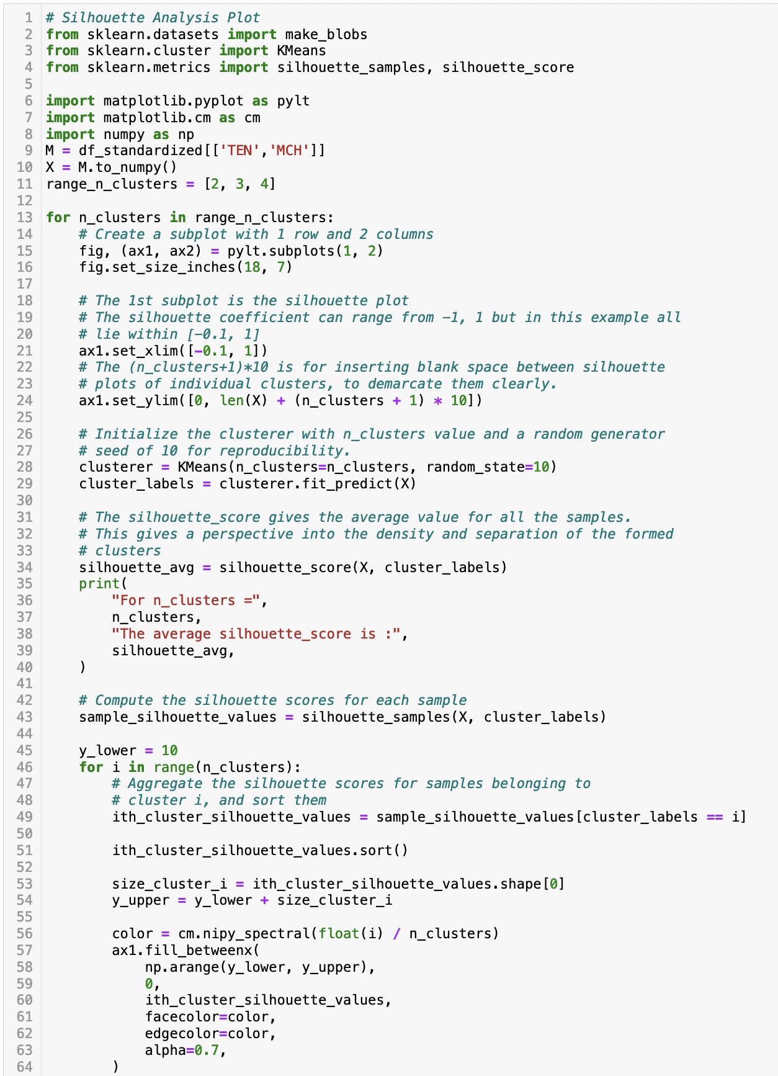
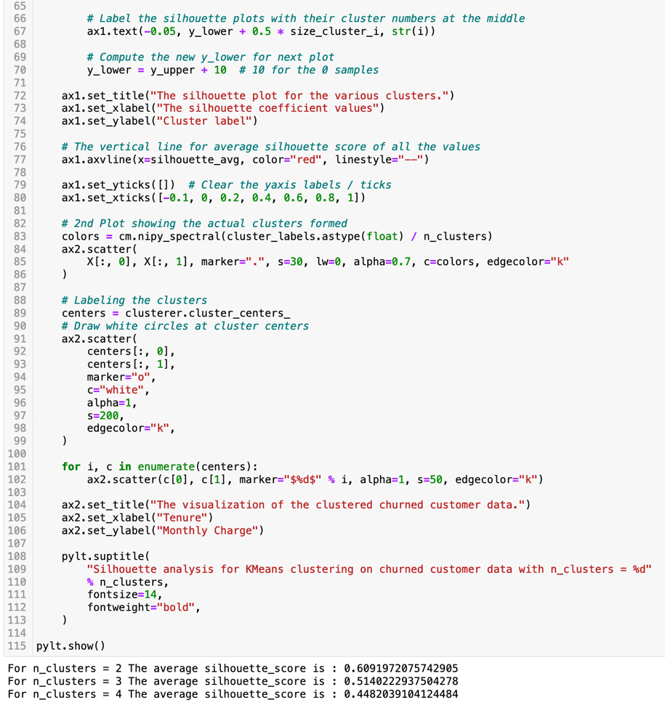
K-Means Analysis: Silhouette Analysis
Notes:
Next, Scikit Learn’s packages make_blobs, KMeans, and silhouette_samples, silhouette_score are used to create the silhouette analysis plots for each k. A for loop is used to cycle through the k’s and create the silhouette plots and scatter plots for each. This analysis again verified that two clusters is the optimal number for this data.

Slide 25
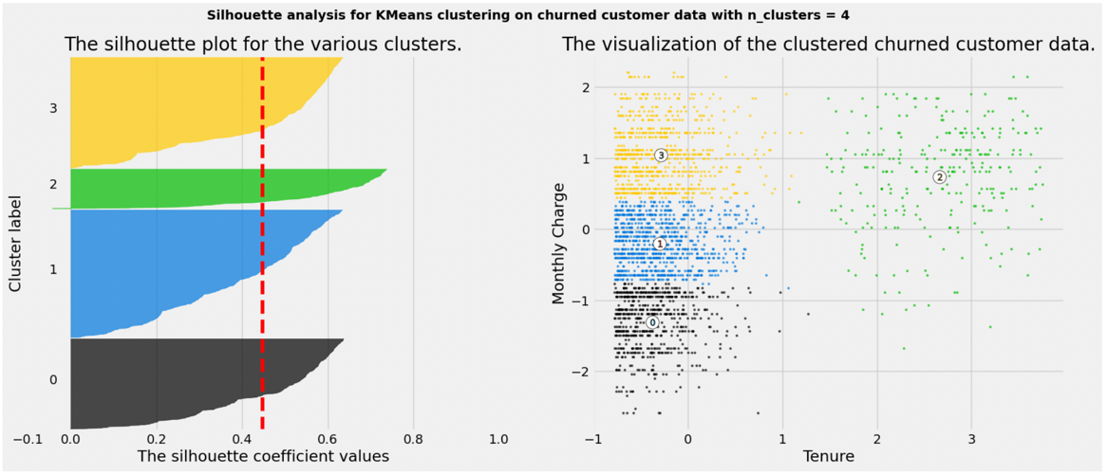
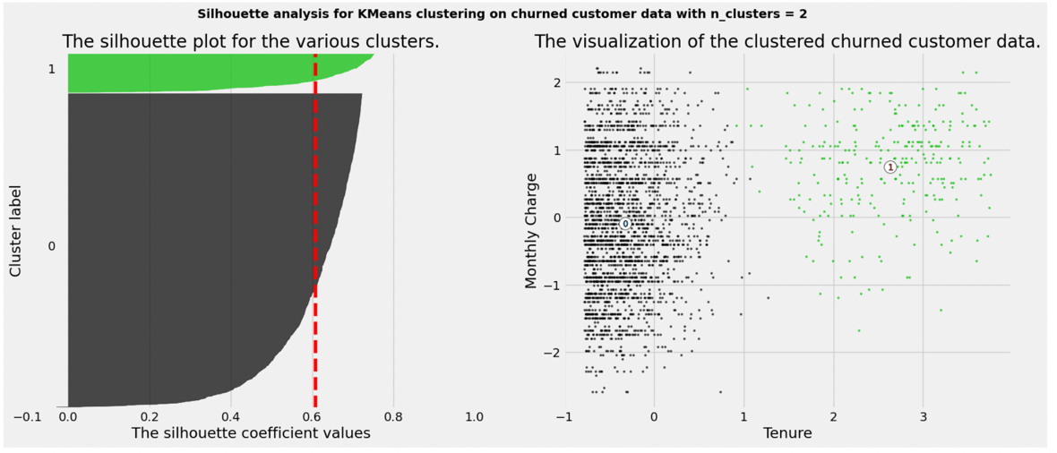
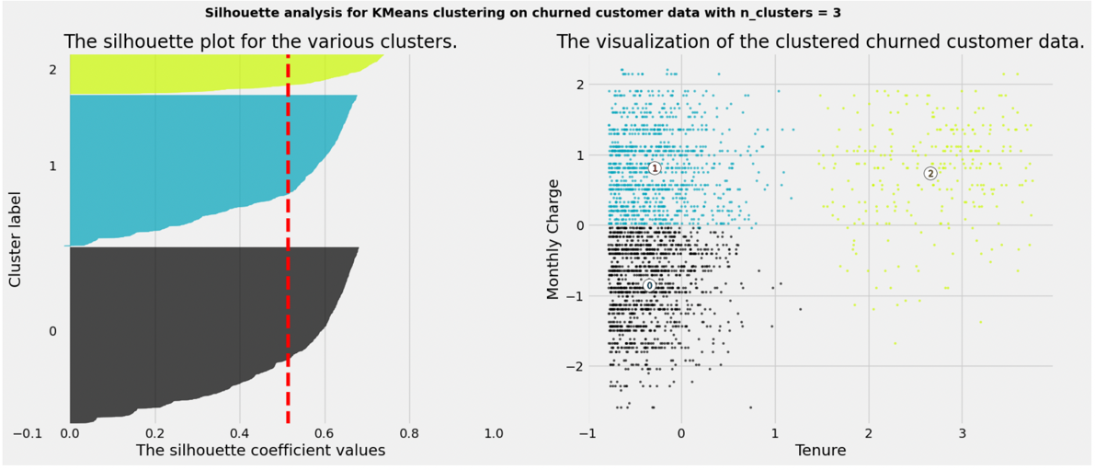
K-Means Analysis: Silhouette Analysis Plots
Notes:
This analysis again verified that two clusters is the optimal number for this data.

Slide 26
Summary and Implications
Results: Data model with two highly concentrated clusters.
Limitations: Determining the number of clusters.
Recommendations: Marketing campaign targeting new customers with higher-than-average monthly charges.
Notes:
The K-Means analysis showed definite clusters of data points in the analysis. These clusters are highly concentrated, showing that the data points all have a small Euclidian distance from the centroid of the cluster. This suggests that the model is accurate and representative of the data. The variables determined to impact the churned customers in the greatest manner are monthly charge and tenure. The higher the monthly charge and the lower tenure values, equate to the customer discontinuing the service with the provider.
A limitation of the analysis was determining the number of clusters that was best for the analysis. There are two methods that are used in this analysis, and they differ in their results. Diving further into the silhouette method and obtaining the coefficients and creating the silhouette analysis helped to clarify the optimal number of clusters.
The results of the K-Means analysis showed that a high monthly charge early into a customer’s service is the main factors for their decision to leave the provider. Creating a marketing campaign to target these customers and offer them a discount incentive for remaining with the service would increase the chance of retaining the customer.

Slide 27

Questions
This Photo by Unknown Author is licensed under CC BY-NC
Notes:
Any questions?

